Slide 1

Exploring the Developer Landscape: Stack Overflow Survey
Part 1
Anna Manina
02/04/2025

Slide 2



OUTLINE
Executive Summary
Introduction
Methodology
Results
Visualization – Charts
Dashboard
Discussion
Findings & Implications
Conclusion
Appendix

Slide 3
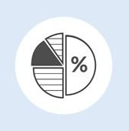
EXECUTIVE SUMMARY
Python, JavaScript, and TypeScript are the top desired languages.
PostgreSQL and MySQL remain the most sought-after databases.
React.js and Node.js dominate frontend and backend choices.
Majority of developers are aged 25-34; most hold a Bachelor's degree, but many rely on self-teaching and online courses.
The industry remains male-dominated, though diversity is increasing.
The U.S., India, and Germany have the highest number of respondents, with emerging tech hubs in Latin America and Southeast Asia.

Slide 4

INTRODUCTION
Overview: This project analyzes the Stack Overflow Developer Survey to uncover key trends in programming languages, databases, platforms, and developer demographics.
Objective: Identify the most desired technologies and career preferences among developers.
Data Scope: The dataset includes responses from developers worldwide, covering programming languages, education levels, and work preferences.
Target Audience:
Aspiring & Professional Developers
Hiring Managers & Tech Recruiters
Tech Companies & Startups
Educators & Bootcamp Instructors
Data Analysts & Industry Researchers.

Slide 5

METHODOLOGY
Data Sources:
Stack Overflow Developer Survey
Job postings
Training portals
Collection Methods:
Web scraping
API access
Dataset imports (.csv, Excel, databases)
Key Wrangling Steps:
Finding and removing duplicates
Finding and imputing missing values
Normalizing data

Slide 6
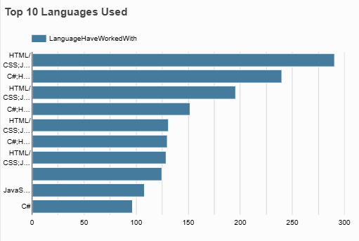
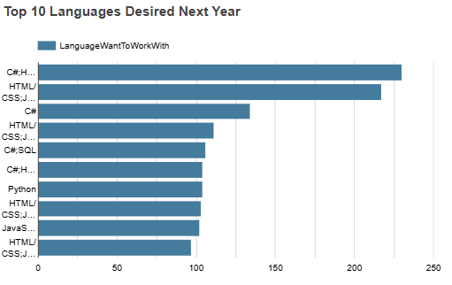
PROGRAMMING LANGUAGE TRENDS
Current Year
Next Year

Slide 7
PROGRAMMING LANGUAGE TRENDS - FINDINGS & IMPLICATIONS
Findings
The most commonly used languages include HTML, JavaScript, SQL, and Python.
Legacy languages like Java and C++ remain widely used, especially in enterprise settings.
PHP and Ruby show a decline in usage.
C++, JavaScript, TypeScript, SQL and Python are among the most desired languages for future work.
Rust and Go are gaining popularity among developers.
Implications
Developers should focus on learning Python, TypeScript, Go, and Rust, as these languages are in high demand.
Companies should prioritize hiring developers with expertise in emerging languages like Rust and Go.
Companies may phase out legacy languages, leading to shifts in required skills for developers.
Programming courses should incorporate high-demand languages like SQL, Python, TypeScript, and Rust.

Slide 8
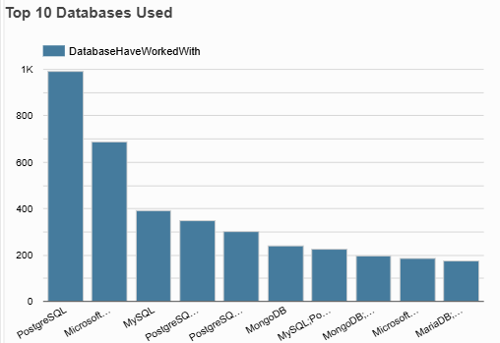
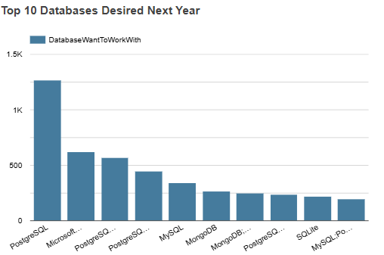
DATABASE TRENDS
Current Year
Next Year

Slide 9
DATABASE TRENDS - FINDINGS & IMPLICATIONS
Findings
PostgreSQL, MySQL, and SQLite continue to dominate due to their reliability and open-source nature.
Microsoft SQL Server and Oracle remain widely used, especially in enterprise environments.
PostgreSQL leads as the most desired database, showing continuous growth in popularity.
Redis and Cassandra are seeing increased interest due to their performance in distributed and real-time applications.
Implications
Learning PostgreSQL, MongoDB, and cloud databases will provide competitive career advantages.
Businesses should invest in scalable, cloud-based, and NoSQL solutions to improve flexibility.
Database courses should incorporate both relational and NoSQL technologies to meet industry demands.
The shift toward distributed and cloud-native databases is shaping the future of data management.

Slide 10
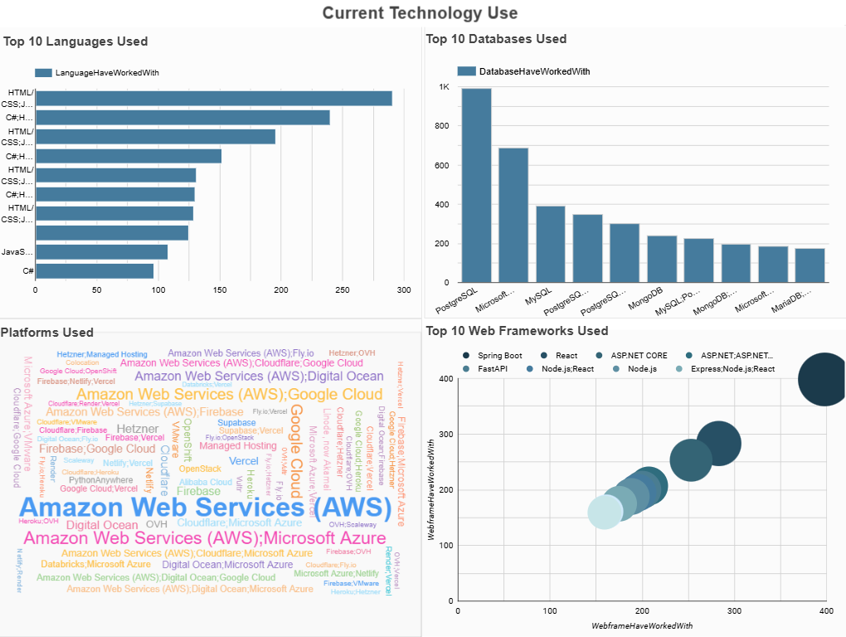

Slide 11
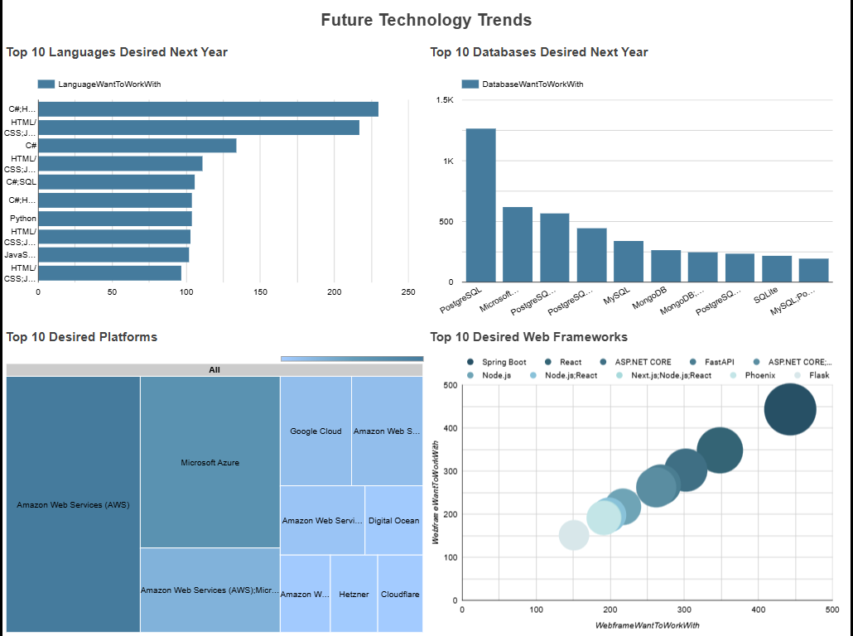

Slide 12
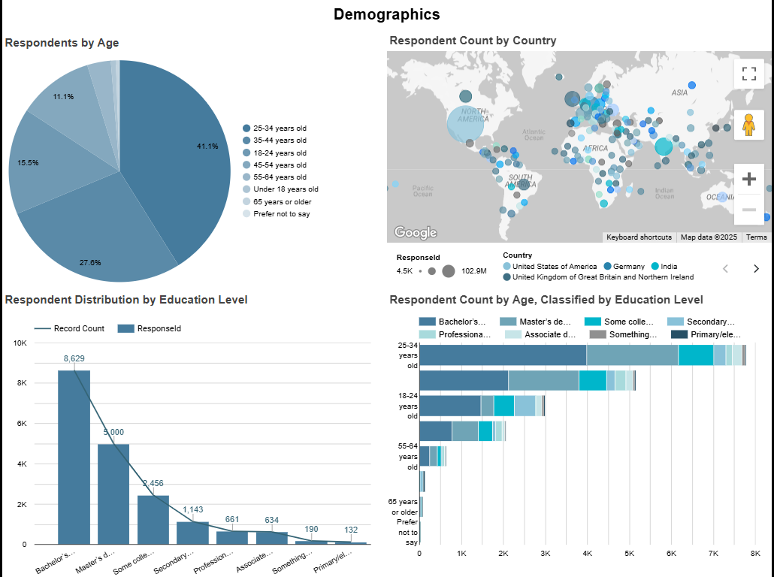

Slide 13

DISCUSSION: Demographics
Age Distribution: the majority of developers are between 25-34 years old, followed by younger professionals under 24.
Gender Distribution: the industry remains male-dominated.
Education Background: most developers hold a Bachelor’s degree, but alternative learning paths like bootcamps, online courses, and self-teaching are gaining traction.
Geographic Distribution: the highest number of respondents come from the United States, India, and Germany, reflecting strong tech hubs.

Slide 14
OVERALL FINDINGS & IMPLICATIONS
Findings
Python and JavaScript remain dominant, reinforcing their importance in web development, data science, and AI.
The future of databases is cloud-first, scalable, and increasingly NoSQL-driven.
Cloud-based platforms (AWS, Docker, Kubernetes) are widely preferred, signaling a shift toward cloud computing.
The developer workforce is becoming younger, more global, and more self-taught, but gender diversity remains a challenge.
Implications
Shifting technology trends require continuous learning.
Cloud and scalable technologies are the future.
Diversity and inclusion efforts need strengthening.
Hiring strategies need to adapt to changing trends: Demand for cloud, AI, and full-stack development skills will shape future hiring trends.

Slide 15

CONCLUSION
Technology trends are shifting, with modern languages (Rust, Go, TypeScript), cloud platforms, and NoSQL databases becoming more dominant.
The tech industry is evolving rapidly, with new technologies, and self-taught developers.
The workforce is becoming global, with emerging tech hubs growing and remote work expanding opportunities worldwide.
Companies, educators, and developers must adapt to these shifts by embracing continuous learning, cloud adoption, and inclusive hiring practices.

Slide 16
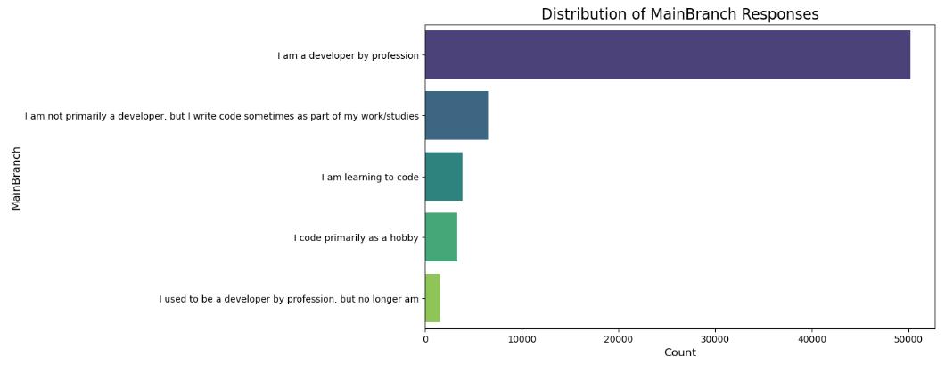
APPENDIX 1: Developer Role Distribution

Slide 17
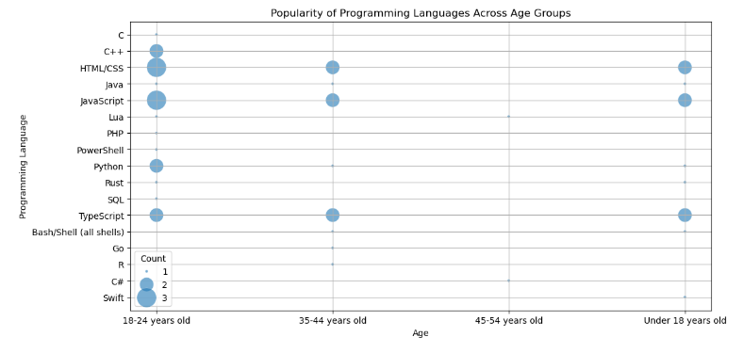
APPENDIX 2: Programming Languages by Age

Slide 18
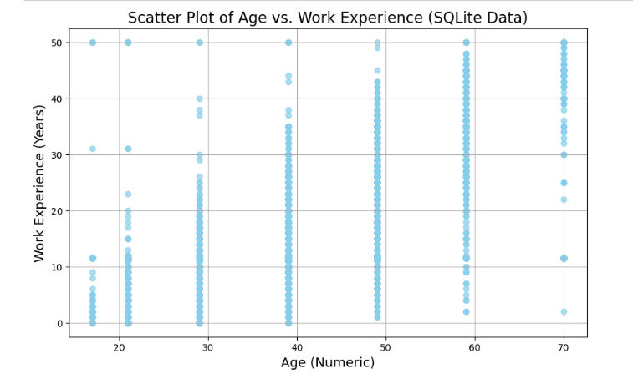
APPENDIX 3: Age vs Work Experience

Slide 19
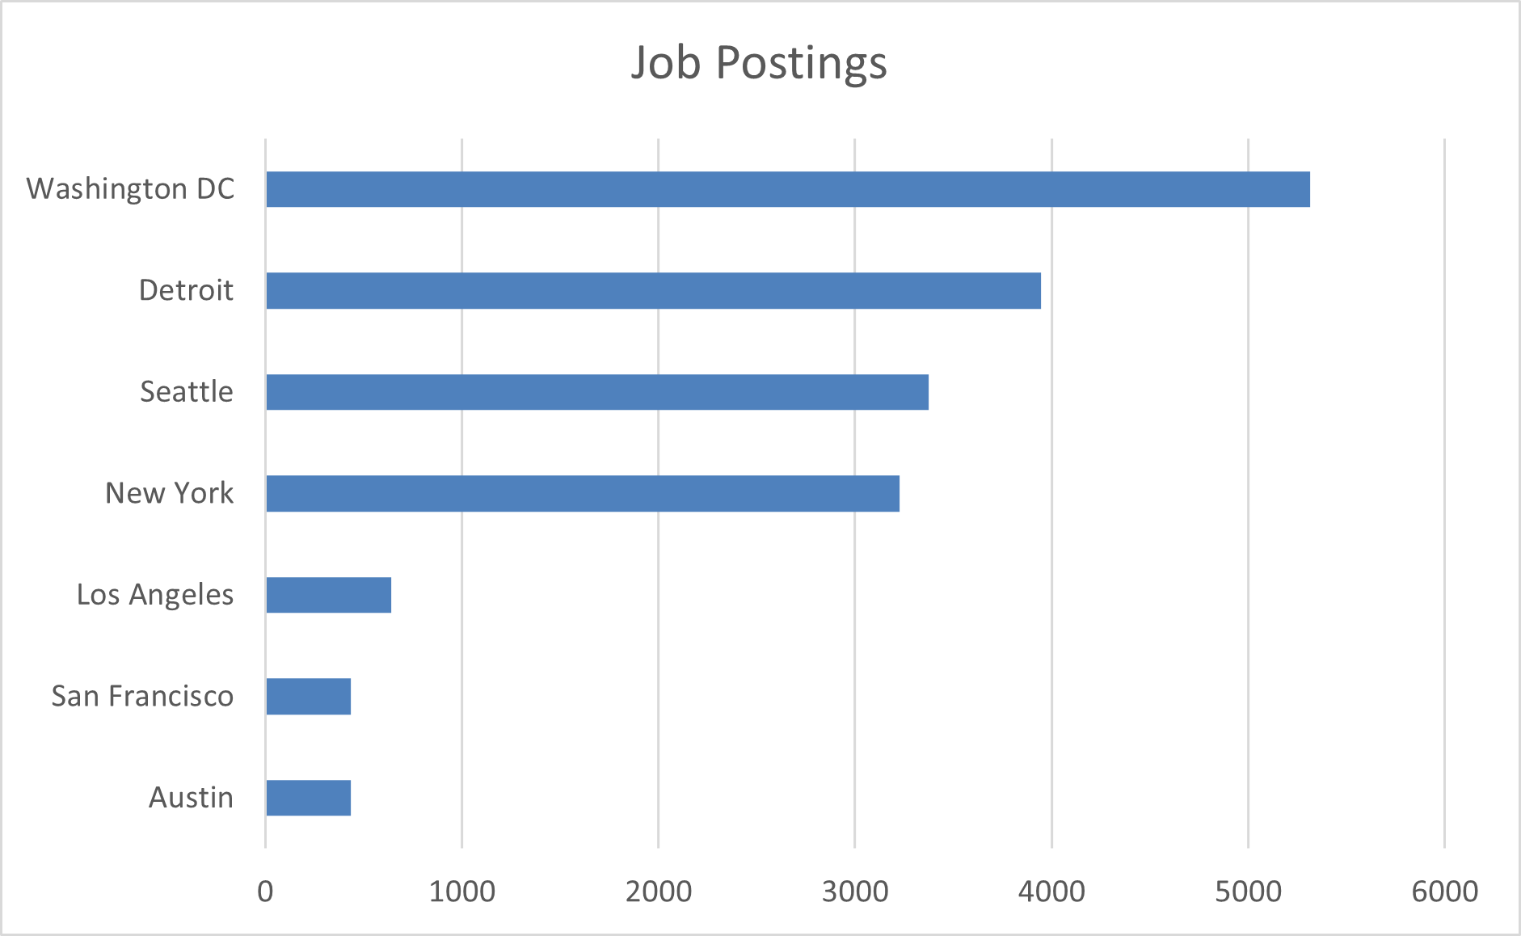
JOB POSTINGS

Slide 20
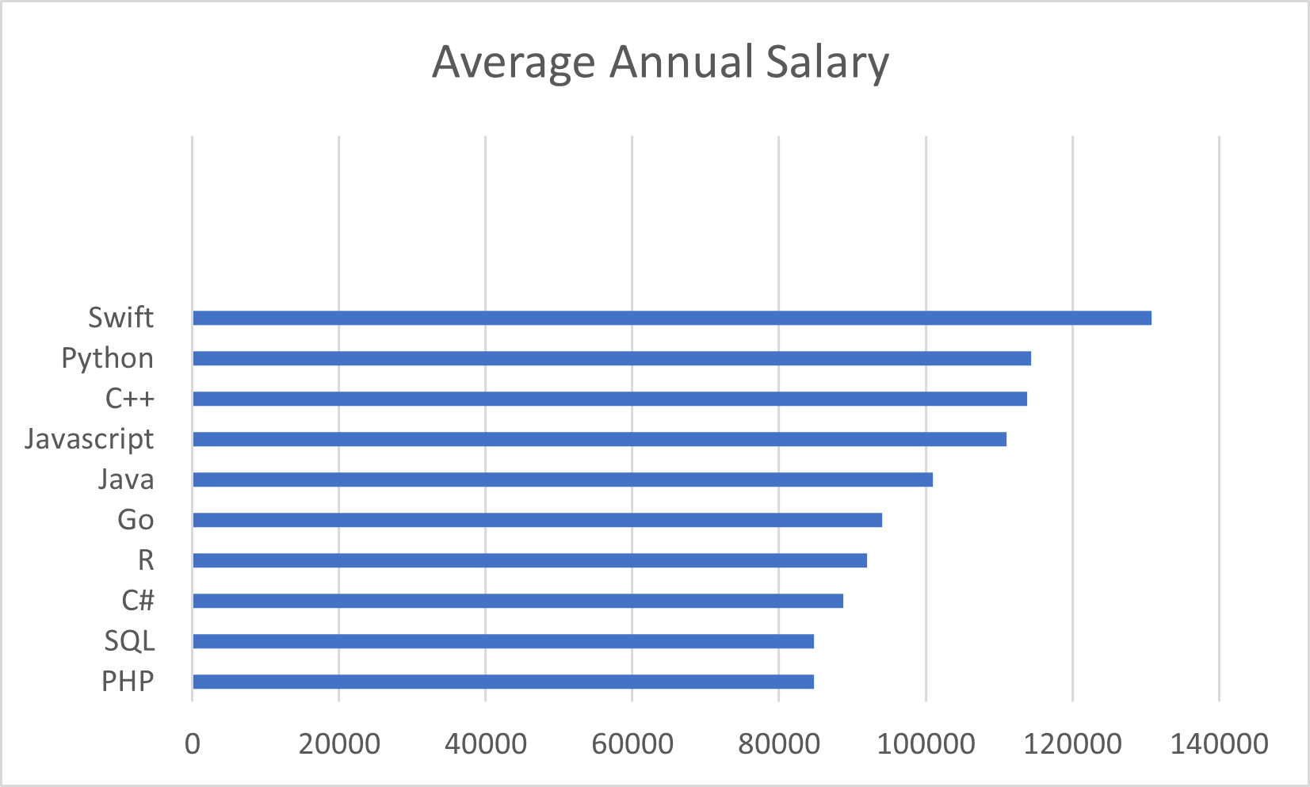
POPULAR LANGUAGES

